Slide 1
Arraylist
Md. Shafqat Talukder Rakin
Lecturer, Department of CSE,
United International University
Email id : shafqat@cse.uiu.ac.bd
Acknowledged: Abdullah Al Jubair

Slide 2
The ArrayList class
ArrayList supports dynamic arrays that can grow as needed.
Arraylist can have duplicate elements.
An ArrayList is a variable-length array of object references.
An ArrayList can dynamically increase or decrease in size.
Array lists are created with an initial size. When this size is exceeded, the collection is automatically enlarged. When objects are removed, the array can be shrunk.

Slide 3
Dynamic Allocation of ArrayList
The following is a very basic idea explaining the working of the array when the array becomes full and if we try to add an item:
● Creates a bigger-sized memory on heap memory (for example memory of double size).
● Copies the current memory elements to the new memory.
● The new item is added now as there is bigger memory available now.
● Delete the old memory.

Slide 4
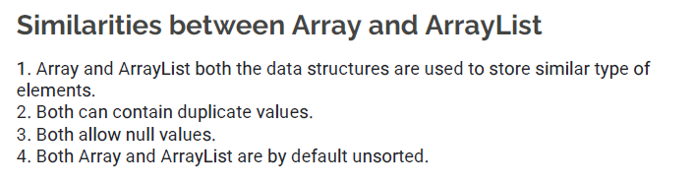
Array vs ArrayList

Slide 5
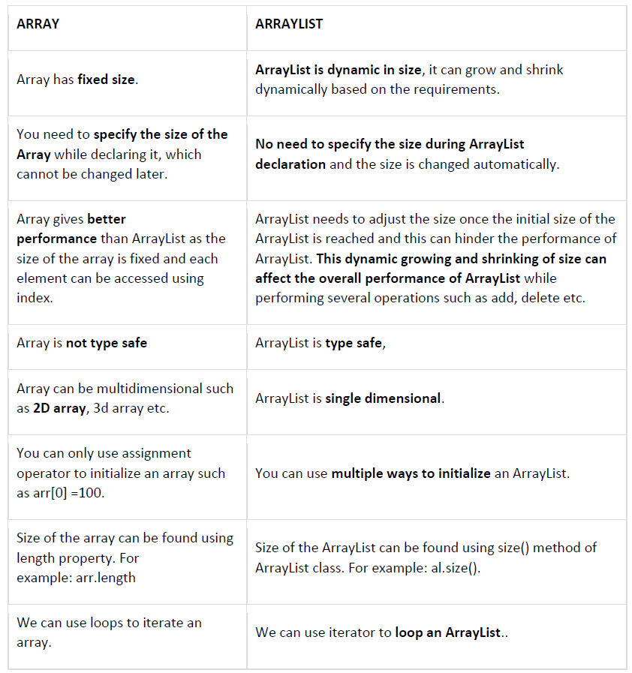
Array vs ArrayList

Slide 6
Implementation
ArrayList inherits AbstractList class and implements the List interface.

Slide 7
Declaring an ArrayList
ArrayList<data_type> list_name = new ArrayList<>();
ArrayList<Integer> arr = new ArrayList<>();
ArrayList<String> arr2 = new ArrayList<>();

Slide 8
Operations performed in ArrayList
● Adding element to List/ Add element
● Changing elements/ Set element
● Removing elements/Delete element
● Iterating elements
● get elements
● add elements in between two number
● Sorting elements
● ArrayList size

Slide 9
Add an element
ArrayList <String> list = new ArrayList<>();
// Adding items to arraylist
list.add("String 1");
list.add("String 2");
list.add("String 3");

Slide 10
Get an element
// Access items at a specific index
String s1 = list.get(0); // s1 = "String 1"
String s2 = list.get(2); // s2 = "String 3"
Find index of an element
int index = list.indexOf(“string 1”);
Return the index of first element for multiple occurences
If not present in the Arraylist, returns -1

Slide 11
Remove an element
// Remove specific item of an index
list.remove(2);
Search an element
List.contains(“string 3”);
//return true if contains otherwise returns false

Slide 12
More operations
// Add to specific index
list.add(1, "String 4");
// Change item at specific index
list.set(1, "String 5");
// Size of arraylist
int size = list.size();
// Clear the list
list.clear();
System.out.println(list.size()); // prints 0

Slide 13
Sort an Arraylist
Collections.sort(list)
Sort list alphabetically or numerically in ascending order

Slide 14
Sort an Arraylist in descending order
Collections.sort(list,Collections.reverseOrder());

Slide 15
ArrayList of different type of objects
ArrayList x=new ArrayList<>(); x.add("apple"); x.add(1); x.add('3'); System.out.println(x); if(x.contains("1")){ System.out.println("contains");//doesn't print }

Slide 16
Hashset
A HashSet is a collection of items where every item is unique

Slide 17
Hashset
HashSet<Integer> a=new HashSet<>(); a.add(33); a.add(11); a.add(33); System.out.println(a); a.remove(1); for(int i:a) System.out.println(i); System.out.println("size of hashset:"+a.size()); if(a.contains(3)){ System.out.println("contains"); }

Slide 18
ArrayList of Class objects

Slide 19
Consider Student class
public class student { public int id; public String name; public double cgpa; student(int i, String n, double c){ name=n;
id=i;
cgpa=c; } public String toString(){ return "name:"+name+" id:"+id+" cgpa:"+cgpa; } }

Slide 20
Create ArrayList of students
class studentArrayList{ public static void main(String[] args) { ArrayList<student> studentList=new ArrayList<>(); studentList.add(new student(3,"Mina",3.85)); studentList.add(new student(6,"Abir",3.25)); studentList.add(new student(4,"Rina",3.75)); for(student s:studentList) System.out.println(s); Collections.sort(studentList);//error } }

Slide 21
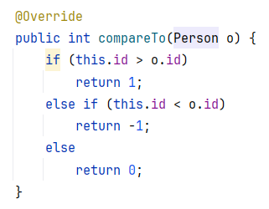
Sort ArrayList of class objects according to id(int) in ascending order overriding compareTo method

Slide 22
Sort ArrayList of class objects according to name(string) in ascending order
Collections.sort(studentList, new Comparator<student>() { public int compare(student o1, student o2) { return o1.name.compareTo(o2.name); } });

Slide 23
Sort ArrayList of class objects according to id(int) in ascending order
Collections.sort(studentList, new Comparator<student>() { public int compare(student o1, student o2) { return o1.id -o2.id; } });

Slide 24
Sort ArrayList of class objects according to cgpa(double) in ascending order
Collections.sort(studentList, new Comparator<student>() { public int compare(student o1, student o2) { if(o1.cgpa > o2.cgpa) return 1; return -1; } });
Output:
name: Abir id:6 cgpa:3.25
name: Rina id:4 cgpa:3.75
name: Mina id:3 cgpa:3.85

Slide 25
Sort ArrayList of class objects according to cgpa(double) in descending order
Collections.sort(studentList, new Comparator<student>() { public int compare(student o1, student o2) { if(o2.cgpa > o1.cgpa) return 1; return -1; } });
Output:
name: Mina id:3 cgpa:3.85
name: Rina id:4 cgpa:3.75
name: Abir id:6 cgpa:3.25

Slide 26
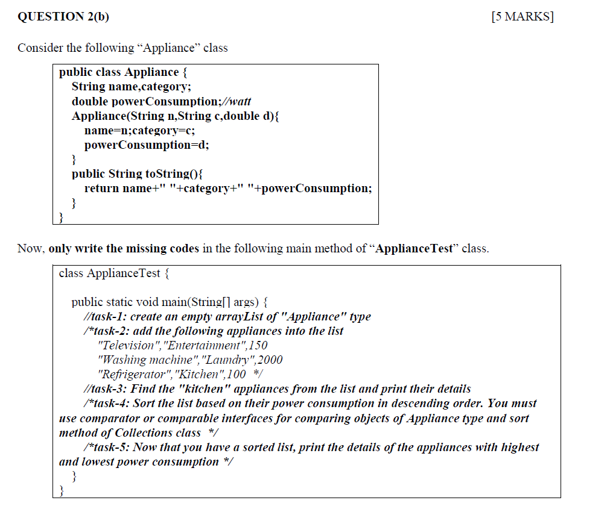
Spring 2024 Question 2(b)

Slide 27
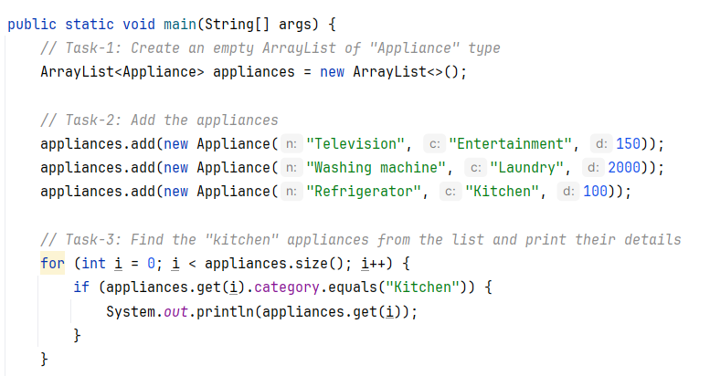
Spring 2024 Question 2(b)

Slide 28
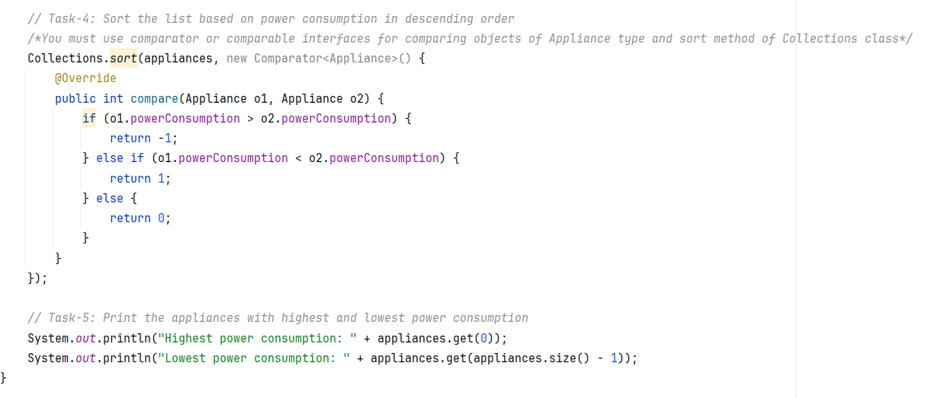
Spring 2024 Question 2(b)

Slide 29
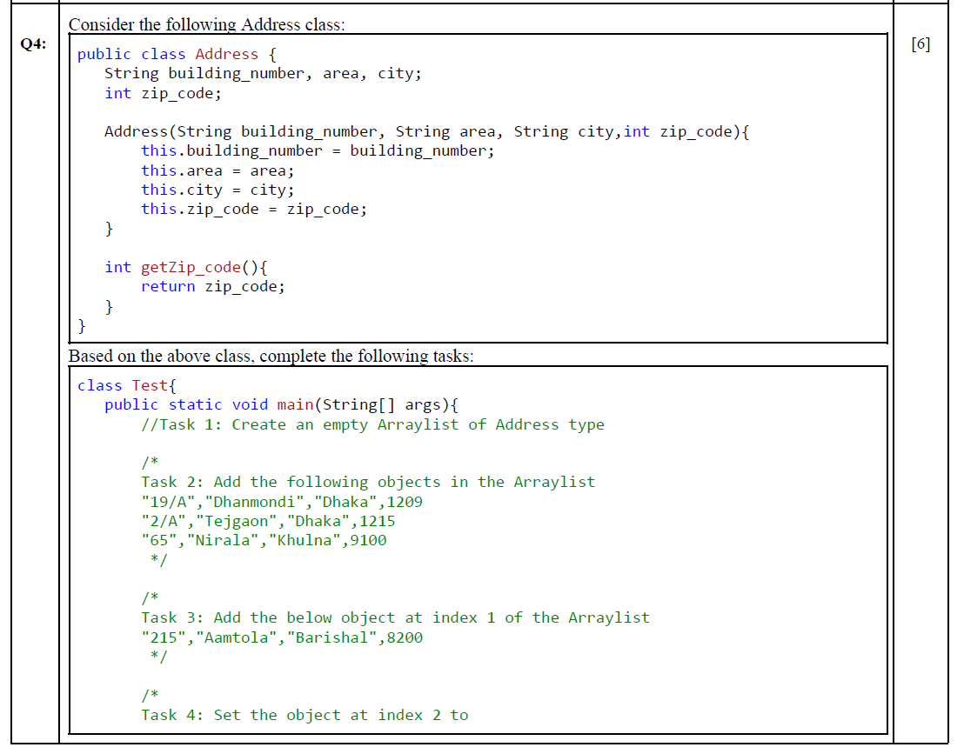
Fall 2023 Question 4

Slide 30
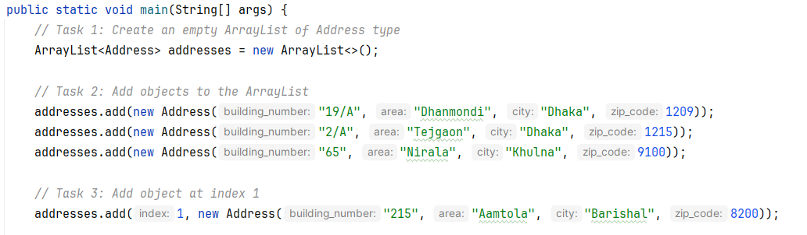
Fall 2023 Question 4

Slide 31
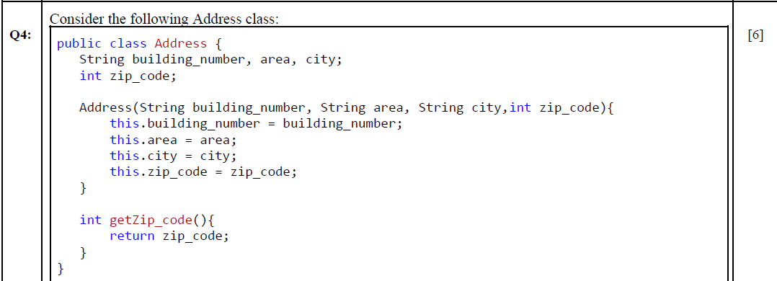

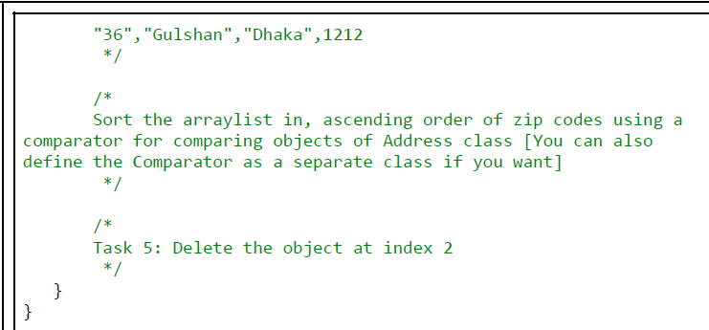
Fall 2023 Question 4

Slide 32
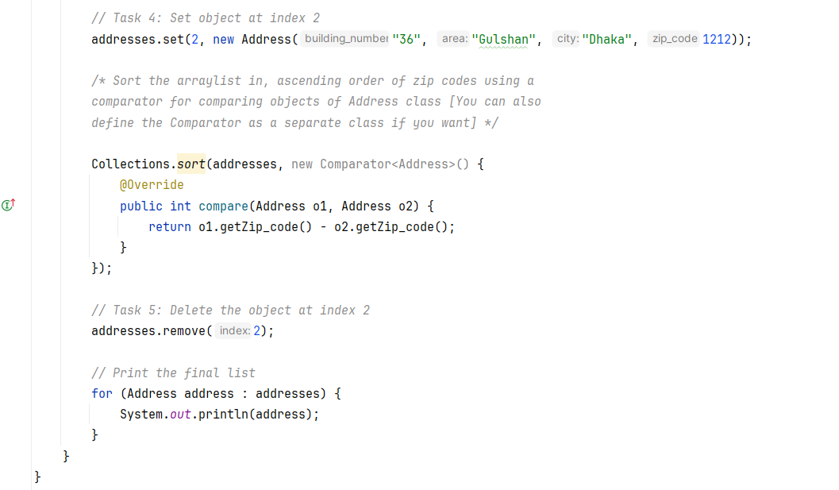
Fall 2023 Question 4

Slide 33
Thank You

